Slide 1
You should never invest in Mutual Funds
CA. Ashish Modani
Certified Financial Planner

Slide 2
Why I am saying so…
They are subject to market risk which are
Political Risk
Geographical Risk
Business Cycle Risk
FIIs Risk
They don’t offer guarantee like you get in PPF, FDs etc.
There is lot of volatility in mutual funds.

Slide 3
But one fine day…
You met someone who deals in Mutual Funds.
He explained you the benefits of Mutual Funds
He said that they offer high return on investments but are tax efficient too. He also explained how conveniently you will be able to save money by signing up for SIP.
You also got to know about SIP from media as they have also started to talk about it.
And unfortunately you got carried away..

Slide 4
And the biggest reason you got carried away was the fact that…

Slide 5
So you started investing Rs. 10000 per month based on fantastic returns that you saw over last one year…
And since SIP is so hot now-a-days, the BUT OBVIOUS choice was SIP.
You said to yourself that I will not invest in MF but will invest in SIP as you have been told that SIP gives best return

Slide 6
But in 1 year of your investment in SIP, you found that
Notes:
Rs. 10000 invested per month

Slide 7
You got scared and thought before money becomes half and goes to 61000 instead of todays 91000…better withdraw… Markets anyways are looking bad..economy is sinking, things are really bad..
And I anyways told you..
YOU SHOULD NOT INVEST IN MUTUAL FUNDS

Slide 8
But the moment you stopped investing, next year the scheme gave fantastic returns….

Slide 9
You said to yourself – “Ah!! Things have improved now.. uncertainty is over and economy is in good shape.. Let me try once more.. I guess this is the BEST TIME

Slide 10
You started again….

Slide 11
Not again!!
You are wondering, why it is happening with me only..
This time money has not gone in negative.. At least my principal is safe.
I should invest for one more year.
Also Experts in media are telling that SIP should be for long term.. I have only given one year.. I guess I should give one more year
2 years will make it a long term…RIGHT!!!
You decided not to quit and give one more year.. Sure this time I will get good returns..

Slide 12
But something else only happened…

Slide 13
मैने तो पहले ही कहा था
You should never invest in Mutual Funds

Slide 14
Let me suggest you a BEST scheme with very long term track record..
Had you invested Rs. 10000 per month

Slide 15
Now that I have suggested you BEST SCHEME would you like to try once again…
Just for your information, the so called “better scheme” and “best scheme” are one and the same scheme.
I have only taken different time period of the scheme and presented data in front of you..

Slide 16
Even with the best, they have failed to create wealth

Slide 18
The biggest reason why investors don’t make money from such a beautiful product like mutual funds is because they do not know how to manage their behaviour.

Slide 19
So unless you don’t know how to manage your behaviour, You should not invest in mutual funds

Slide 20
Before you plunge into Mutual Funds as an investment tool…
first understand the mistakes which investors should not make when they invest in Mutual Funds..

Slide 21
Mistake # 1: Investors give lot of attention to the recent performances

Slide 22
Mistake # 2: Investors like to review their investment in Mutual Funds far too often and far too soon..

Slide 23
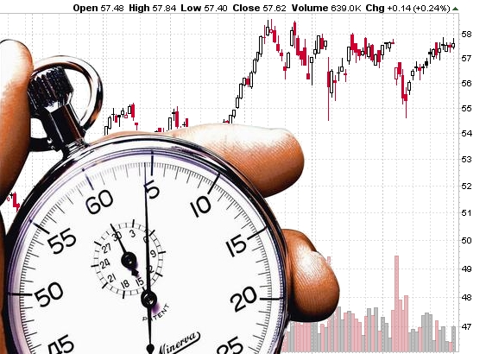
Mistake # 3: Investors do not want to give time to their investments but want to time the market to perfection

Slide 24
The reason for all the above mistakes is that they like focus only on return from investment and not their financial goals.. People want to invest in BEST SCHEME and like to get maximum return.

Slide 25
Focus on your Dreams of your life

Slide 26
Link your Mutual Funds Schemes with your Dreams
SIP for Kids Future
SIP for Retirement
SIP for Travel

Slide 27
At the end, you would need a Financial Coach for your Success

